Slide 1
Customer Behavior Analysis

Slide 2

Comprehensive Scope and Data Pipeline
Dataset Dimensions
The Analysis Stack
Transactional data spanning 3,900 purchases across multiple product categories.
Utilizing industry-standard tools to ensure robust data integrity and visualization.
•
18 Primary Variables
•
Python: Cleaning and pre-proccessing
•
Global Regional Coverage
•
MS SQL: Complex Business Logic
•
Full Demographic Profiling
•
Power BI: Interactive BI Dashboards

Slide 3


Advanced Data Cleaning and Engineering
Refining the Analytical Core
Raw data was processed to eliminate bias and improve structural readability.
• Imputation: Missing Review Ratings filled using category-specific medians.
• Standardization: Column headers converted to snake_case for PostgreSQL compliance.
• Binning: Customer ages categorized into strategic groups (Young Adult to Senior).

Slide 4


Demographic & Financial Insights
Identifying the Primary Revenue Engines

Slide 5
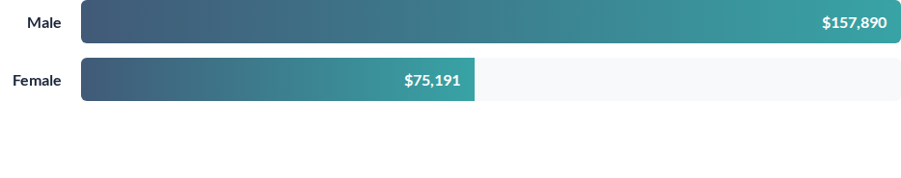
Male Segments Drive Primary Revenue
Male customers contribute roughly 2.1x the revenue of female segments, indicating a dominant market share in current category offerings.

Slide 6
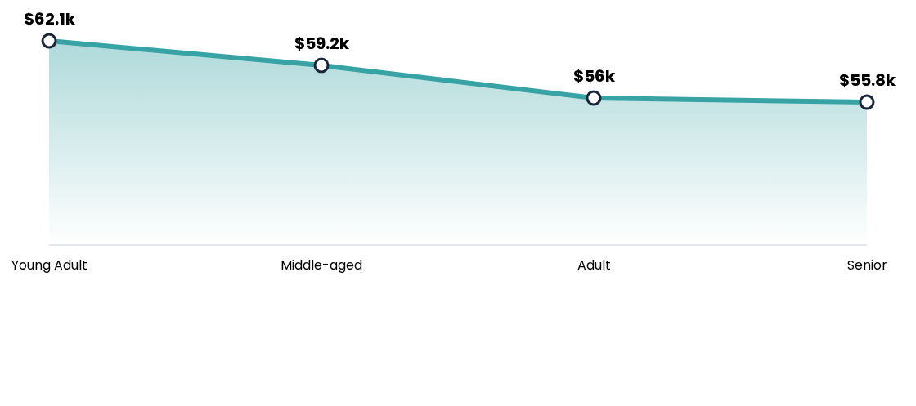
Young Adults and Middle-Aged Lead Spend
Revenue trends show a peak in the Young Adult demographic, with a steady but marginal decline as customer age increases.

Slide 7
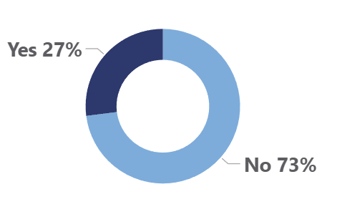
Significant Upside in Subscription Conversion
Non-Subscribers: 73% ($170k)
Active Subscribers: 27% ($62.6k)
Opportunity: Targeted membership conversion for the 73% inactive pool.

Slide 8
Top Rated Products and Category Leaders
Item Category | Top Selling Product | Order Volume
Accessories | Jewelry | 171 Units
Clothing | Blouse / Pants | 171 Units
Outerwear | Jacket | 163 Units
Footwear | Sandals | 160 Units

Slide 9






Behavior-Based Customer Segmentation
Loyal Segment
Returning
New Acquisitions
3,116 Customers
701 Customers
83 Customers
The core stability of the business with recurring purchase history.
Moderate engagement level with potential for loyalty conversion.
Latest cohort requiring onboarding and retention strategies.

Slide 10
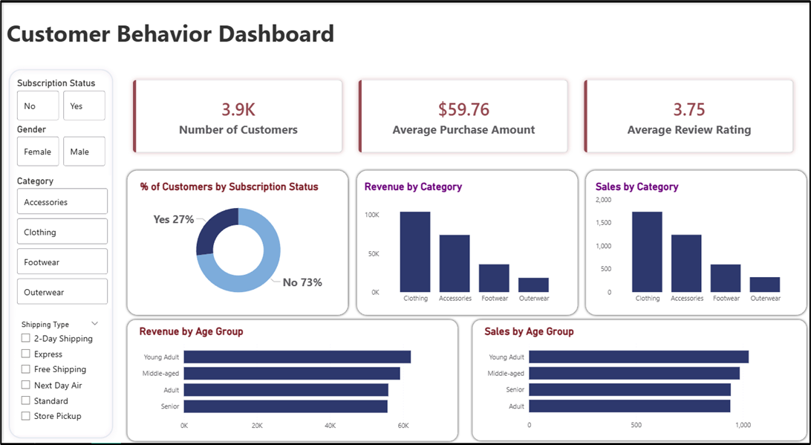
Real-Time Intelligence: Power BI Dashboard
The Visual Command Center
Interactive reporting allows stakeholders to filter by Category, Subscription Status, and Shipping Type.

Slide 11
Strategic Recommendations
Boost Subscription
Promote exclusive benefits for subscribers
Loyalty Programs
Reward repeat buyers to increase retention
Targeted Marketing
Focus on high-revenue segments and express users
Product Positioning
Highlight top-rated products in campaigns

